Slide 1
Mapping Automated Pavement Data to Windshield Visual Survey Data: A Statistical Approach
Jie Zhang, Lihui Bai
Department of Industrial Engineering, University of Louisville
Zhihui Sun
Department chair of Civil and Environmental Engineering, University of Louisville
Xuwen Zhu
Department of Mathematics, University of Louisville

Slide 2
Outline
Mapping Automated Pavement Data to Windshield Visual Survey Data: A Statistical Approach
J. Zhang, L. Bai, Zhihui Sun, and Xuwen Zhu
Introduction
Related works
Data
Factor identification and Data preprocess.
Data Quality Check
Statistical model
Conditional probability based Ensemble tree models
Computational results
Summary and future research
Page 1 of 26

Slide 3
Introduction
Mapping Automated Pavement Data to Windshield Visual Survey Data: A Statistical Approach
J. Zhang, L. Bai, Zhihui Sun, and Xuwen Zhu
Windshield Visual surveys:
Rated by expected technicians.
It may has human errors.
Rating for same road may vary with different technicians.
Automated pavement surveys:
Featuring high resolution image processing and laser surface profilers.
It’s more consistent, accurate and reliable.
It saves time and cost over visual data.
Page 3 of 26

Slide 4
Introduction
Mapping Automated Pavement Data to Windshield Visual Survey Data: A Statistical Approach
J. Zhang, L. Bai, Zhihui Sun, and Xuwen Zhu
However, the transition from the windshield visual survey to automated pavement survey is challenging in three aspects:
Years of windshield visual data collected in the legacy format are of great value for forecasting and analysis, and thus should not be discarded.
The compatibility issue between the new automated data and the windshield visual data in legacy format will be handled.
Study the correlation between automated and visual data.
Therefore, we propose a mapping process from the automated data into the older legacy format.
Page 3 of 26

Slide 5
Related works
Mapping Automated Pavement Data to Windshield Visual Survey Data: A Statistical Approach
J. Zhang, L. Bai, Zhihui Sun, and Xuwen Zhu
The Maryland State Highway Administration (MDSHA) also conducted data collection and data processing tasks based on automated network-level crack detection in 2014.
Timm et. al. sent questionnaire to survey DOT in Alabama to assess automated data collection practice.
Lu et al. used artificial neural network, they proved that the automatic detection system could have reliable accuracy in crack depth detection.
Khadgi et al. used ANOVA and linear regression constructed a bridge between automatic crack detection system and legacy manual visual crack surveys.
Page 4 of 26

Slide 6
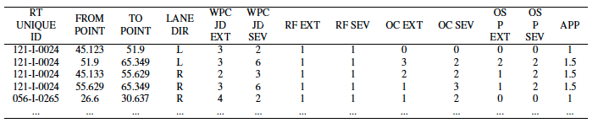
Visual Evaluation System DATA
Mapping Automated Pavement Data to Windshield Visual Survey Data: A Statistical Approach
J. Zhang, L. Bai, Zhihui Sun, and Xuwen Zhu
Visual Evaluation system (VES) has nine factors to rate pavement conditions.
Each factor has a scale range to rate the pavement.
Higher rating is given to poorer condition.
The rating from VES is given based on road segments.
Our study mainly focus on Wheel Path Cracking extent and Wheel Path Cracking severity (WPC_JD_EXT and WPC_JD_SEV), each of which has scale range of 0-9 .
Page 5 of 26

Slide 7
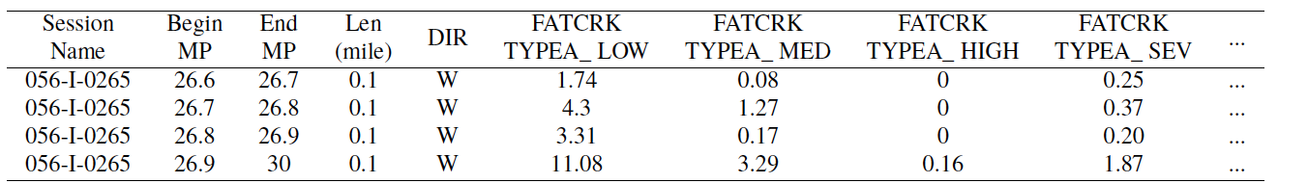
Laser Crack Measurement System Data
Mapping Automated Pavement Data to Windshield Visual Survey Data: A Statistical Approach
J. Zhang, L. Bai, Zhihui Sun, and Xuwen Zhu
Laser Crack Measurement System (LCMS) data is from high resolution images generated by laser surface profiler.
It has approximately 150 different factors.
It records continuous measurement every 0.1 mile.

Slide 8
Data Identification and Data Preprocessing
Mapping Automated Pavement Data to Windshield Visual Survey Data: A Statistical Approach
J. Zhang, L. Bai, Zhihui Sun, and Xuwen Zhu
Factor Identification and Data Preprocessing
Important factors in LCMS were identified by consulting experts in Kentucky Transportation Cabinet (KYTC).
Each factor in VES has several relevant factors in LCMS.
13 variables from LCMS are corresponding to WPC_EXT and 7 variables are corresponding to WPC_SEV.
Mapping data from LCMS to VES using Route ID and from-to points.
For each road segment in VES, 10th, 20th, ……, 90th percentile, standard deviation, skewness, minimum, maximum value, total 13 statistics in LCMS are used in the mapping.
Page 6 of 26

Slide 9
Mapping data from LCMS to VES using Route ID and from-to points.
Mapping Automated Pavement Data to Windshield Visual Survey Data: A Statistical Approach
J. Zhang, L. Bai, Zhihui Sun, and Xuwen Zhu
VES
LCMS
Notes:
Distribution!!

Slide 10
Data Quality Check
Mapping Automated Pavement Data to Windshield Visual Survey Data: A Statistical Approach
J. Zhang, L. Bai, Zhihui Sun, and Xuwen Zhu
Replace all null vales with zero and remove special feature section (e.g., bridges, railroads).
Outliers Identification in LCMS.
Outliers in LCMS my caused by inaccuracy of distance measurement instrument(DMI) and existence of patching or passing lane in the road segments.
Outliers are identified by using lower and upper percentiles in each LCMS factor.
Inconsistency rating between VES and LCMS.
VES and LCMS ratings may have big discrepancy because of different rating date.
Lower and upper percentiles in each LCMS factor and VES rating is used to identify such inconsistency.
Notes:
Vice versa

Slide 11
Outliers Identification in LCMS
Mapping Automated Pavement Data to Windshield Visual Survey Data: A Statistical Approach
J. Zhang, L. Bai, Zhihui Sun, and Xuwen Zhu
For any given VES road:
Calculate lower and upper percentiles (e.g., 10th, 90th) for each VES road in LCMS data.
Numbering each VES road in LCMS by start points.
Find two or more consecutive tenths which are either greater than 90 percentile or smaller than 10 percentile.
If they are in the beginning or the end of the roads, they are possibly caused by DMI, otherwise they are possibly caused by patching or passing lane.

Slide 12
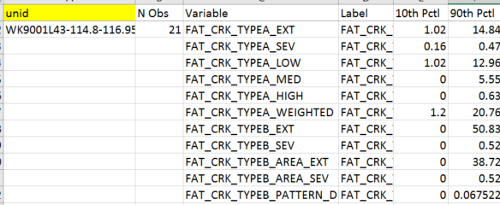
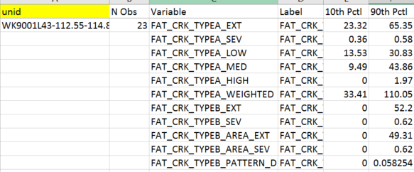
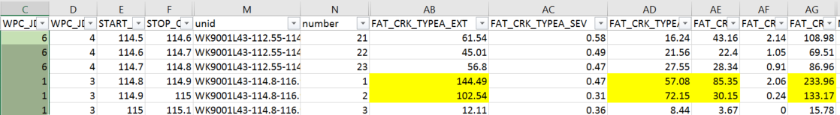
Example: Inaccuracy caused by DMI
Mapping Automated Pavement Data to Windshield Visual Survey Data: A Statistical Approach
J. Zhang, L. Bai, Zhihui Sun, and Xuwen Zhu

Slide 13
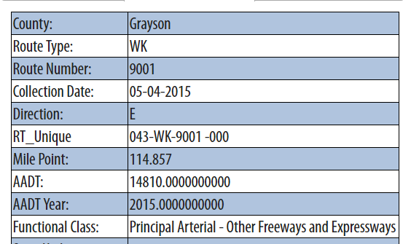
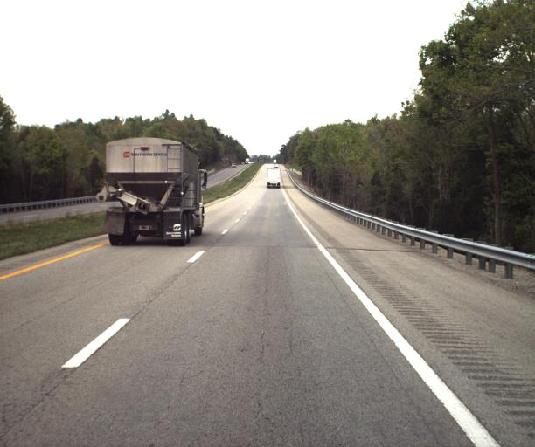
Example: Inaccuracy caused by DMI
Mapping Automated Pavement Data to Windshield Visual Survey Data: A Statistical Approach
J. Zhang, L. Bai, Zhihui Sun, and Xuwen Zhu

Slide 14
Inconsistency rating between VES and LCMS
Mapping Automated Pavement Data to Windshield Visual Survey Data: A Statistical Approach
J. Zhang, L. Bai, Zhihui Sun, and Xuwen Zhu
Calculate lower and upper percentiles (e.g., 20th, 80th) for each VES (e.g., WPC_JD_EXT) level.
For 77 VES roads having WPC_JD_EXT=0,1,2, find values in LCMS factors which are larger than 80th percentile of 2 levels higher.
For 74 VES roads having WPC_JD_EXT=7,8,9, find values in LCMS factors which are smaller than 20th percentile of 2 levels lower.
For other 69 VES roads having WPC_JD_EXT in the middle, find values in LCMS factors which are either smaller than 20th percentile of 2 levels lower or larger than 80th percentile of 2 levels higher.
If a roads has half of corresponding LCMS factors which are larger than 80th percentile of 2 levels higher or smaller than 20th percentile of 2 levels lower, then it is a mismatch.

Slide 15
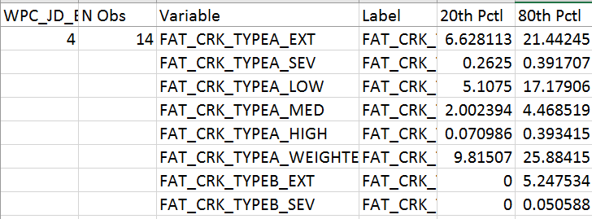
Inconsistency rating between VES and LCMS
Mapping Automated Pavement Data to Windshield Visual Survey Data: A Statistical Approach
J. Zhang, L. Bai, Zhihui Sun, and Xuwen Zhu

Slide 16
Number of available data
Mapping Automated Pavement Data to Windshield Visual Survey Data: A Statistical Approach
J. Zhang, L. Bai, Zhihui Sun, and Xuwen Zhu
8429 of 8588 LCMS data entries can be used.
220 roads segments out of 500 in VES can have match in LCMS in 2015.
47 roads segments from VES are removed because of large discrepancy with LCMS, which leads to 173 available data.

Slide 17
The ensemble Learning Approach:
Mapping Automated Pavement Data to Windshield Visual Survey Data: A Statistical Approach
J. Zhang, L. Bai, Zhihui Sun, and Xuwen Zhu
Ensemble methods are meta-algorithms that combine several machine learning models (known as basic learners) into one predictive model in order to decrease variance, bias, or improve predictions.
It is a proven method for improving the accuracy of the model and works in most cases.
It makes the model more robust and stable thus ensuring quality performance on the test cases in most scenarios.
Decision tree classifier is used as basic learners in this study.

Slide 18
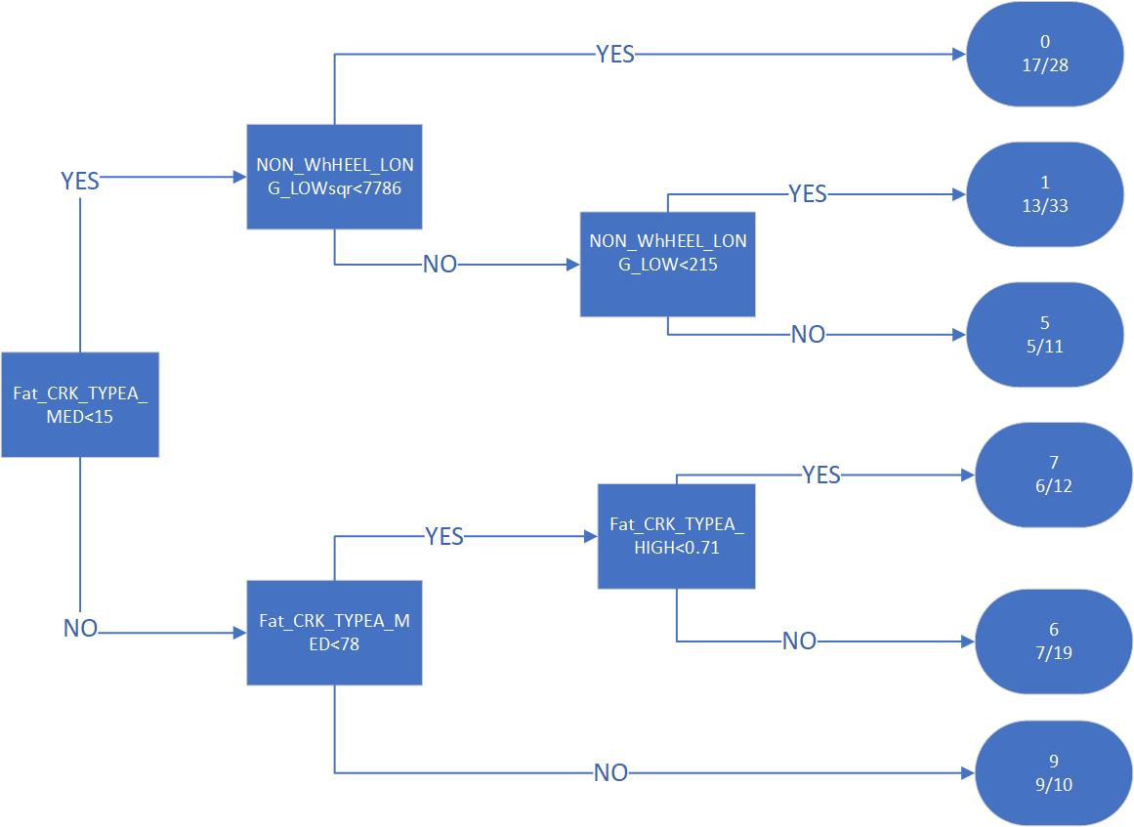
Decision tree example
Mapping Automated Pavement Data to Windshield Visual Survey Data: A Statistical Approach
J. Zhang, L. Bai, Zhihui Sun, and Xuwen Zhu

Slide 19
Ensemble model with decision tree
Mapping Automated Pavement Data to Windshield Visual Survey Data: A Statistical Approach
J. Zhang, L. Bai, Zhihui Sun, and Xuwen Zhu
10th, 20th, ……, 90th percentile, standard deviation, skewness, minimum, and maximum value, total 13 statistics in LCMS of each road segments are used to build trees .
All 13 trees are assembled together by using conditional probability as weight.
Experts in KYTC confirm that tolerance error range is [-1, +1].
Conditional probability is defined as probability of given a road has prediction K from a decision tree, its true value is within [K-1, K+1].
The conditional probability is calculated in the validation process.

Slide 20
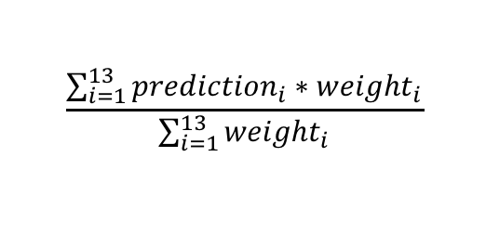
Data rotation
Mapping Automated Pavement Data to Windshield Visual Survey Data: A Statistical Approach
J. Zhang, L. Bai, Zhihui Sun, and Xuwen Zhu
In order to make full use of 173 data, we propose a complex data rotation method where each single data is used at least once for validation and once for testing.
Leave 1 road for test.
In remaining 172, leave 1 road for validation.
Use 171 roads to build 13 trees, and predict the 1 validation data in step 1.
Repeat step 1-2 172 times.
Evaluate the conditional probability of each tree in predicting the 172 validation data and assign their weights accordingly. (trees with better accuracy receives higher weights)
Use 172 roads to build a final model. This will be the DT model based on the current testing data.
Predict the 1 test road using the final model in step 5 and it’s corresponding conditional probability with:
Repeat A-B 173 times and get final accuracy, i.e., confusion matrix.
$$\frac{\sum_{i=1}^{13}{{prediction}_{i}∗{weight}_{i}}}{\sum_{i=1}^{13}{{weight}_{i}}}$$

Slide 21
Data rotation
Mapping Automated Pavement Data to Windshield Visual Survey Data: A Statistical Approach
J. Zhang, L. Bai, Zhihui Sun, and Xuwen Zhu
test
Segment 1
Repeat
172 times to
get conditional
Probability:
Pr{Tr=[k-1, k+1]|pr=k}
Segment 2
validation
Segment 3
Repeat 173 times
Segment 4
Training 2
Segment …
Training 1
Segment …
Segment 172
Segment 173

Slide 22
Result: WPC_EXT
Mapping Automated Pavement Data to Windshield Visual Survey Data: A Statistical Approach
J. Zhang, L. Bai, Zhihui Sun, and Xuwen Zhu
 | Actual value
Predict value |  | 0 | 1 | 2 | 3 | 4 | 5 | 6 | 7 | 8 | 9
 | 0 | 25 | 11 | 4 | 1 | 2 | 1 | 0 | 0 | 0 | 0
 | 1 | 4 | 12 | 5 | 2 | 5 | 3 | 3 | 0 | 0 | 0
 | 2 | 0 | 3 | 8 | 7 | 4 | 2 | 2 | 0 | 0 | 0
 | 3 | 0 | 0 | 2 | 0 | 2 | 1 | 0 | 0 | 0 | 0
 | 4 | 0 | 0 | 0 | 3 | 0 | 4 | 0 | 1 | 2 | 1
 | 5 | 0 | 0 | 0 | 0 | 0 | 1 | 2 | 2 | 1 | 0
 | 6 | 0 | 0 | 0 | 0 | 0 | 0 | 1 | 4 | 2 | 1
 | 7 | 0 | 0 | 0 | 0 | 0 | 0 | 3 | 3 | 3 | 1
 | 8 | 0 | 0 | 0 | 0 | 0 | 1 | 3 | 2 | 3 | 2
 | 9 | 0 | 0 | 0 | 0 | 0 | 0 | 1 | 2 | 1 | 14
72.25 % predictions are within tolerance error range [-1, +1], 38.72 % predictions are accurate.

Slide 23
Result: WPC_SEV
Mapping Automated Pavement Data to Windshield Visual Survey Data: A Statistical Approach
J. Zhang, L. Bai, Zhihui Sun, and Xuwen Zhu
 | Actual value
Predict value |  | 0 | 1 | 2 | 3 | 4 | 5 | 6 | 7 | 8 | 9
 | 0 | 20 | 3 | 1 | 0 | 0 | 0 | 0 | 0 | 0 | 0
 | 1 | 9 | 28 | 10 | 6 | 1 | 1 | 1 | 1 | 0 | 0
 | 2 | 0 | 6 | 17 | 9 | 3 | 2 | 1 | 1 | 0 | 1
 | 3 | 0 | 0 | 2 | 7 | 7 | 0 | 1 | 0 | 0 | 0
 | 4 | 0 | 0 | 0 | 1 | 7 | 2 | 4 | 0 | 2 | 1
 | 5 | 0 | 0 | 0 | 1 | 1 | 2 | 3 | 0 | 1 | 3
 | 6 | 0 | 0 | 0 | 0 | 0 | 0 | 0 | 1 | 0 | 3
 | 7 | 0 | 0 | 0 | 0 | 0 | 0 | 0 | 1 | 0 | 1
 | 8 | 0 | 0 | 0 | 0 | 0 | 0 | 0 | 0 | 0 | 1
 | 9 | 0 | 0 | 0 | 0 | 0 | 0 | 0 | 0 | 0 | 0
79.19 % predictions are within tolerance error range [-1, +1], 47.39 % predictions are accurate.

Slide 24
Summary
Mapping Automated Pavement Data to Windshield Visual Survey Data: A Statistical Approach
J. Zhang, L. Bai, Zhihui Sun, and Xuwen Zhu
Key factors in both VES and LCMS are identified to map data from LCMS to VES.
A systematic way to clean the outliers from LCMS data and data mismatch in LCMS data and VES data is established.
Develop a decision tree based ensemble model as a bridge to link VES and LCMS datasets.
Conditional probability is used as weight to assemble trees.

Slide 25
Future research
Mapping Automated Pavement Data to Windshield Visual Survey Data: A Statistical Approach
J. Zhang, L. Bai, Zhihui Sun, and Xuwen Zhu
Identify roads that have large discrepancy between actual and predicted values.
Clean the 2017 LCMS data using the data cleaning procedure proposed previously.
Use data 2017 for additional testing or even training.

Slide 26
Thank you!
Mapping Automated Pavement Data to Windshield Visual Survey Data: A Statistical Approach
J. Zhang, L. Bai, Zhihui Sun, and Xuwen Zhu
Questions?

